Slide 1
Problems of small populations
A crash course in evolutionary principles
Conservation Biology EEB 115/515
Nathalie Sommer

Slide 2
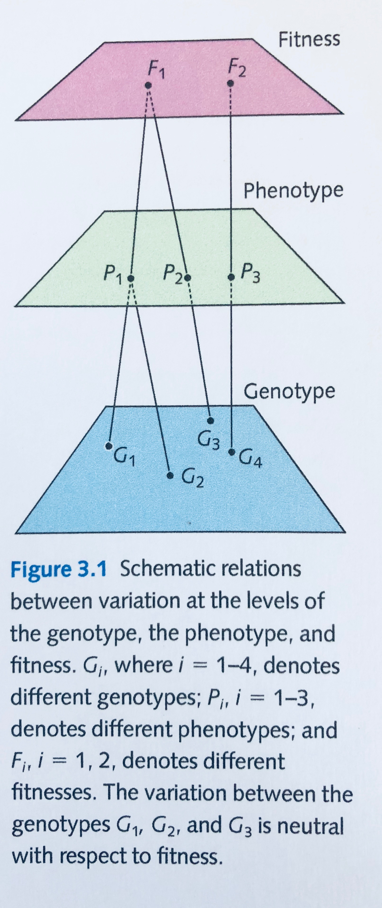
Key Concepts
Traits vary among individuals
Traits are heritable
There is variation in reproductive success across individuals
Not all offspring survive to reproduce
Genotype = genes
Phenotype = what you see
Fitness = differential reproductive success
“Ability to make successful grand-kids”
Reproduction & Survival
Stearns & Hoekstra
Notes:
“Survival of the fittest” is a misconception!
If you live forever but make no offspring, you have no fitness

Slide 3
Evolutionary Principles
Evolution = change in allele frequency over time in populations
A population is a group of interbreeding individuals of the same species
Gene pool = sum total of all alleles within a population
Gene frequency = # of specific allele
total #of alleles

Slide 4
Four Forces of Evolution (remember: change in allele frequency in a pop over time)
Selection
Environment acts on the phenotype
Some phenotypes have lower fitness
Over time, those phenotypes (& their genotypes) are lost in the population
Mutation
Random change, at the level of the gene
Occurs during mitosis or meiosis
Flow
Movement of genes between populations
Requires BOTH immigration & mating
Drift
Change in allele frequency due to random chance
Always occurs, but its effects are seen at a greater magnitude in small pops

Slide 5
Origins of Genetic Variation
Sexual recombination (≠ evolution)
Mutation
Flow
But how is variation maintained in the face of evolutionary forces that will erode variation?
When are evolutionary forces balanced to maintain variation?
Notes:
Flow = Genetic Rescue

Slide 6
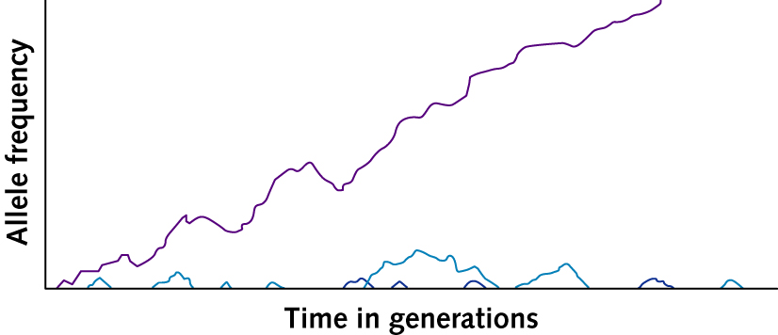
1. Mutation-Drift Balance
When would drift be in balance with mutation?
Drift erodes variation (fixation = allele substitution)
Mutation introduces new variation
Drift would be in balance with mutation when: allele substitution rate = mutation rate

Slide 7
2. Mutation-Selection Balance
When would erosion of genetic variation due to selection be balanced by the introduction of new variation by mutation?
Mutation rate per locus Selection against mutant alleles
Frequency of new mutant alleles
=

Slide 8
3. Opposing-Selection Balance
When mutations are adaptive (or maladaptive), new alleles are driven to fixation (or loss)
However, if selection is acting in opposing directions simultaneously, adaptive/maladaptive mutations can also occur at intermediate frequencies (e.g. heterosis in sickle-cell anemia)

Slide 9
Summary of genetic variation
Origins of genetic variation
Recombination
Mutation
Migration
Maintenance of variation
Mutation-drift balance
Mutation-selection balance
Opposing selection
Eroded by evolution?
Maintain the fuel for evolution

Slide 11
Plasticity
Same genotypes, different environment
Best examples of plasticity are driven by different environmental conditions during development
Acclimation
Same genotypes, different environment
Change is short term adjustment
Notes:
Plasticity vs acclimation
Acclimation vs plasticity is weather vs climate. Acclimation is a short term adjustment to a new environmental circumstance and it is mostly physiologically or metabolically based. Acclimation is easily reversible.

Slide 12
An “evolved” population ≠ an “adapted” population
Notes:
Evolution does not connote adaptation. Beyond the forces of randomness:
Evolutionary “traps”. The environment has changed. The “adaptive” trait is now maladaptive
Artefacts! Physiology is constrained. Spandrels in cathedrals were not developed for their beauty. They were artefacts of designing arches.

Slide 13
Take-aways
Evolution does not have intent or direction
Individuals do not evolve
Acclimation vs Adaptation
Adaptive evolution vs Neutral evolution
Genetic variation = evolutionary flexibility
Selection and drift erode genetic variation
Flow and mutation promote genetic variation
Flow and mutation can result in maladaptation
Notes:
Adaptive evolution = process of change in a population driven by variation in reproductive success that is correlated with heritable variation in a trait
Neutral evolution = Changes in allele frequency that occur because genes are are not correlated with reproductive success are influenced by random processes

Slide 14
Activity: Integrating concepts
Exploring evolutionary problems of small populations
https://www.radford.edu/~rsheehy/Gen_flash/popgen/

Slide 15
Discussion: Wolves of Isle Royale Peterson et al. 1998

Slide 16
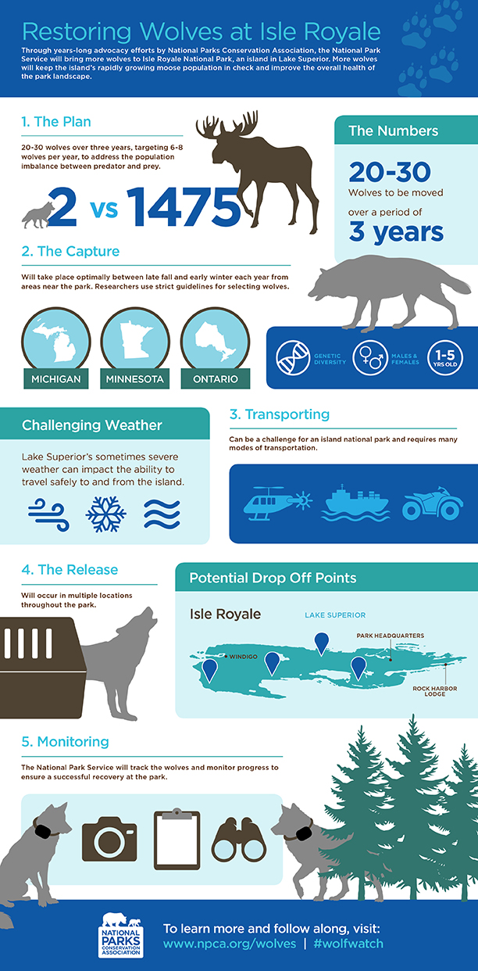
Notes:
Update on the Wolves of Isle Royale

